Slide 1
Green university of Bangladesh
Computer science and Engineering
Name: Jakirul Islam
ID: 193002101
Department of CSE
Topic :Number system

Slide 2
What is number system?

Slide 3
Types of number system :
Binary number system
Octal number system
Decimal number system
Hexadecimal number system

Slide 4
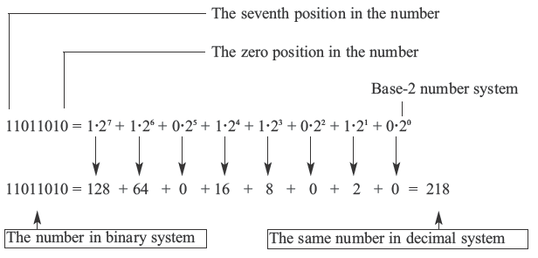
Binary number system :
Characteristics :
The computer represents values(0,1)
Has only 2 digits 0 and 1
The maximum value of a single digits is 1
This number system is used in computer
Example : 1101

Slide 5
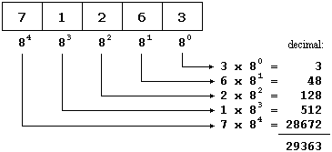
Octal number system:
Characteristics :
Has total 8 symbols or digits ( 0,1,2,3,4,5,6,7)
The maximum value of a single digits is 7
Each position of a digit represents a specific
power of the base 8
Example: 1234

Slide 6
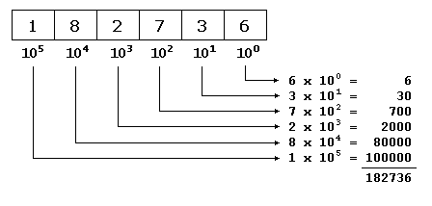
Decimal number system :
Characteristics :
Has 10 symbols or digits (0, 1, 2, 3, 4, 5, 6, 7, 8, 9)
Hence its base 10
The maximum value of a single digit is 9
Example : 789

Slide 7
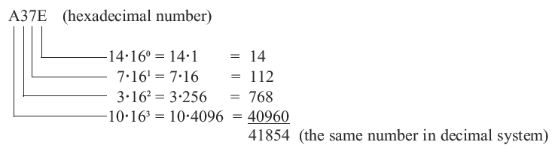
Hexadecimal number system:
Characteristics:
Has total 16 symbols or digits (0, 1, 2, 3, 4, 5, 6, 7, 8, 9, A, B, C, D, E, F).
Hence its base = 16
The symbols A, B, C, D, E and F represent the decimal values 10, 11, 12, 13, 14 and 15 respectively
The maximum than the value of a single of the base digit is 15
Example : A3E

Slide 8
References :
3.Wikipedia(2009)https://en.wikipedia.org/wiki/Binary_number#:~:text=In%20mathematics%20and%20digital%20electronics,referred%20to%20as%20a%20bit. [Accessed 25 Aug 2020 ]
4.Wikipedia ()https://en.wikipedia.org/wiki/Octal https://www.google.com/search?q=octal+number+system+wikipedia&hl=en&sxsrf=ALeKk01KyJx1bufhTb8RyOay9xwHrOms6Q:1598370977509&source=lnms&tbm=isch&sa=X&ved=2ahUKEwjxrdXy27brAhWPOcAKHUerAnsQ_AUoAXoECAwQAw&biw=1366&bih=625 [accessed 25 Aug 2020]
5.Joseph Needham (1959). "Decimal System". Science and Civilisation in China, https://www.google.com/search?q=decimal+number+system+wikipedia&tbm=isch&ved=2ahUKEwit6vqu3bbrAhXB_IUKHTDmDzIQ2- [accessed 25 Aug 2020]
6. Wikipedia()https://en.wikipedia.org/wiki/Hexadecimal https://bih=625&biw=1366&hl=en&sxsrf=ALeKk039x--Xk5gKI6AMm8ZwZuMKszcIew%3A1598373667748&ei=Iz9FX96NLciAgQaj7bCQDg&q=hexadecimal+number+system+wikipedia&oq=hexadecimal+number+system+wikipedia&gs_lcp=CgZwc3ktYWIQDDIECAAQRzIECAAQRzIECAAQRzIECAAQRzIECAAQRzIECAAQRzIECAAQRzIECAAQR1AAWABg6hBoAHABeACAAQCIAQCSAQCYAQCqAQdnd3Mtd2l6wAEB&sclient=psy-ab&ved=0ahUKEwieq7z15bbrAhVIQMAKHaM2DOIQ4dUDCA0 [accessed 25 Aug 2020]

Slide 9

ny question

Slide 10


